Slide 1
TestRail Introduction Session
Jeffrey Zhang

Slide 2
Agenda
1. Why choose TestRail
2. User management
3. Suite/Section/Case management & automation Test

Slide 3
Why choose TestRail
Modern test management for your team
1. All in one place: manage, organize and track all your testing efforts in a central place.
2. Web-based: easily access TestRail with your entire team – either hosted on your or our servers.
3. Modern interface: testing with a beautiful and highly productive user interface.

Slide 4
Why choose TestRail
Perfect for agile & traditional testing approaches
1. Any workflow: a great choice for any team, whether you use an agile or traditional approach.
2. Any team size: teams of one to 1000s of testers love working with TestRail every day.
3. Any method: manage your functional, exploratory and automated tests with ease.

Slide 5
Why choose TestRail
Flexible project organization
Manage all your ongoing test projects in TestRail and have access to all relevant project details at your fingertips, including milestones, active test runs and past results.
Easily archive completed projects, enable multiple project teams to work in parallel and track your projects' progress with TestRail's powerful interface.

Slide 6
Why choose TestRail
Rich & powerful test case management
1. Rich test cases help your team verify your application's functionality and requirements.
2. Easily manage all details in a structured way, including preconditions, steps and expected results.
3. Use rich-text formatting, attach files & screenshots and customize fields for your needs.

Slide 7
Why choose TestRail
Easily organize test suites, sections & cases
1. Organize your test cases in suites and section hierarchies.
2. Easily manage all details in a structured way, including preconditions, steps and expected results. Full test case history to track changes and ensure transparency.
3. Baselines for multiple branches and versions when you need it.

Slide 8
Why choose TestRail
Other advantages
1. Execute test runs and track results that matter
2. Project milestones, releases and iterations
3. Built-in actionable real-time metrics and reports
4. Time estimates and unique progress forecasts
5. Test automation and REST API
6. Reference coverage and requirement integration
7. Highly flexible and customizable for your needs

Slide 9
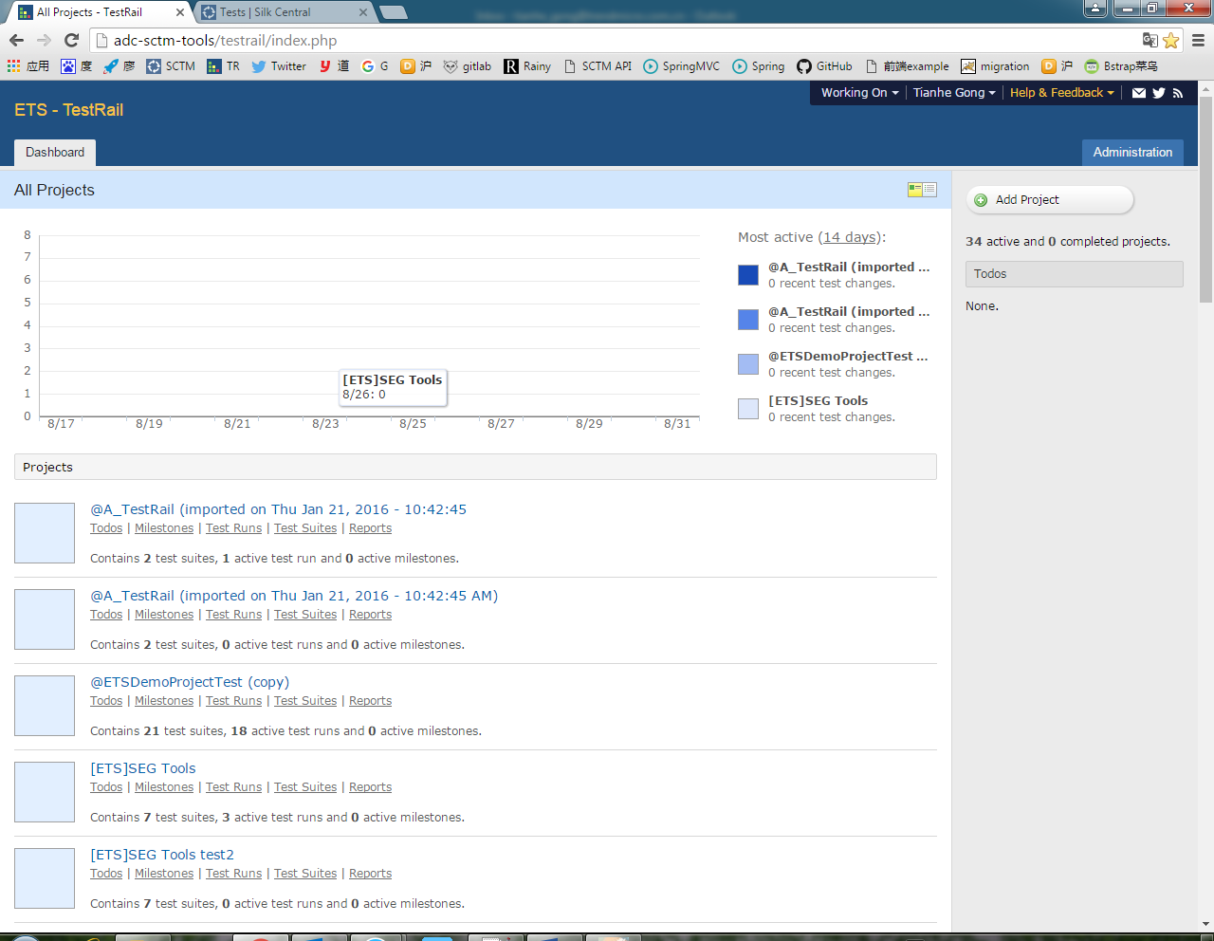
User management
This is dashboard
Click “Administrator”
to manage users
TestRail project list

Slide 10
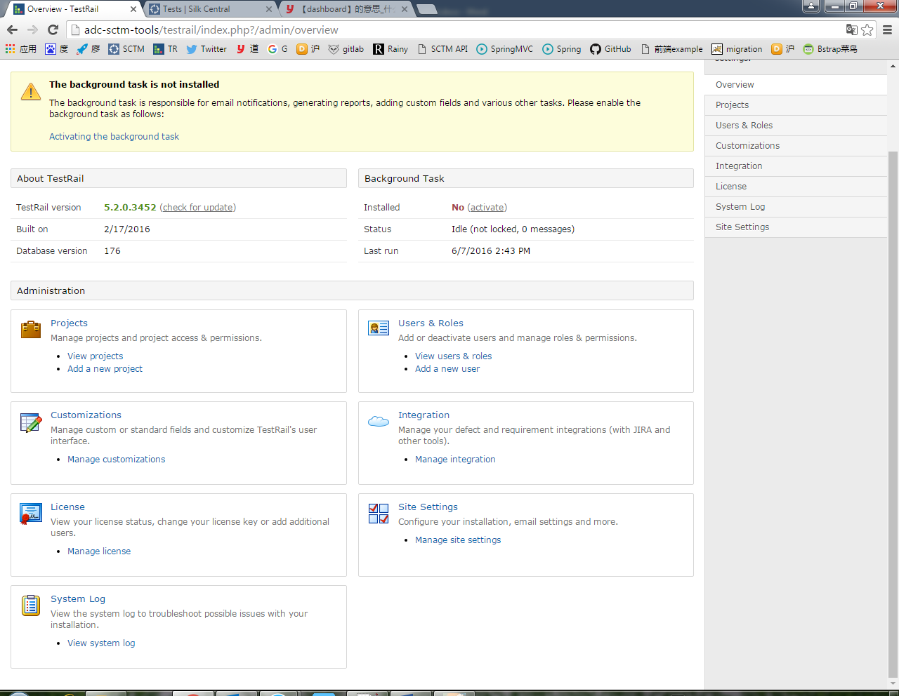
User management
Project management
User & Role management

Slide 11
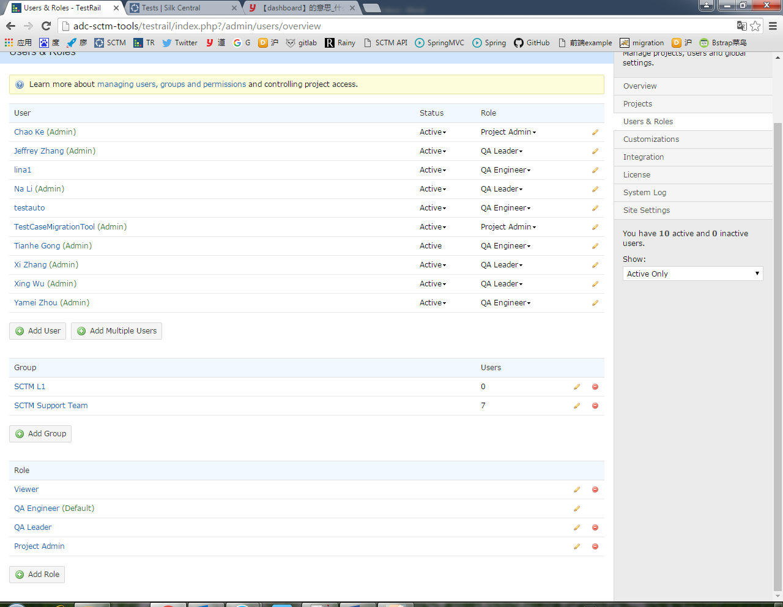
User management
Users
Click “Add User” to create a new user
Groups
Roles

Slide 12
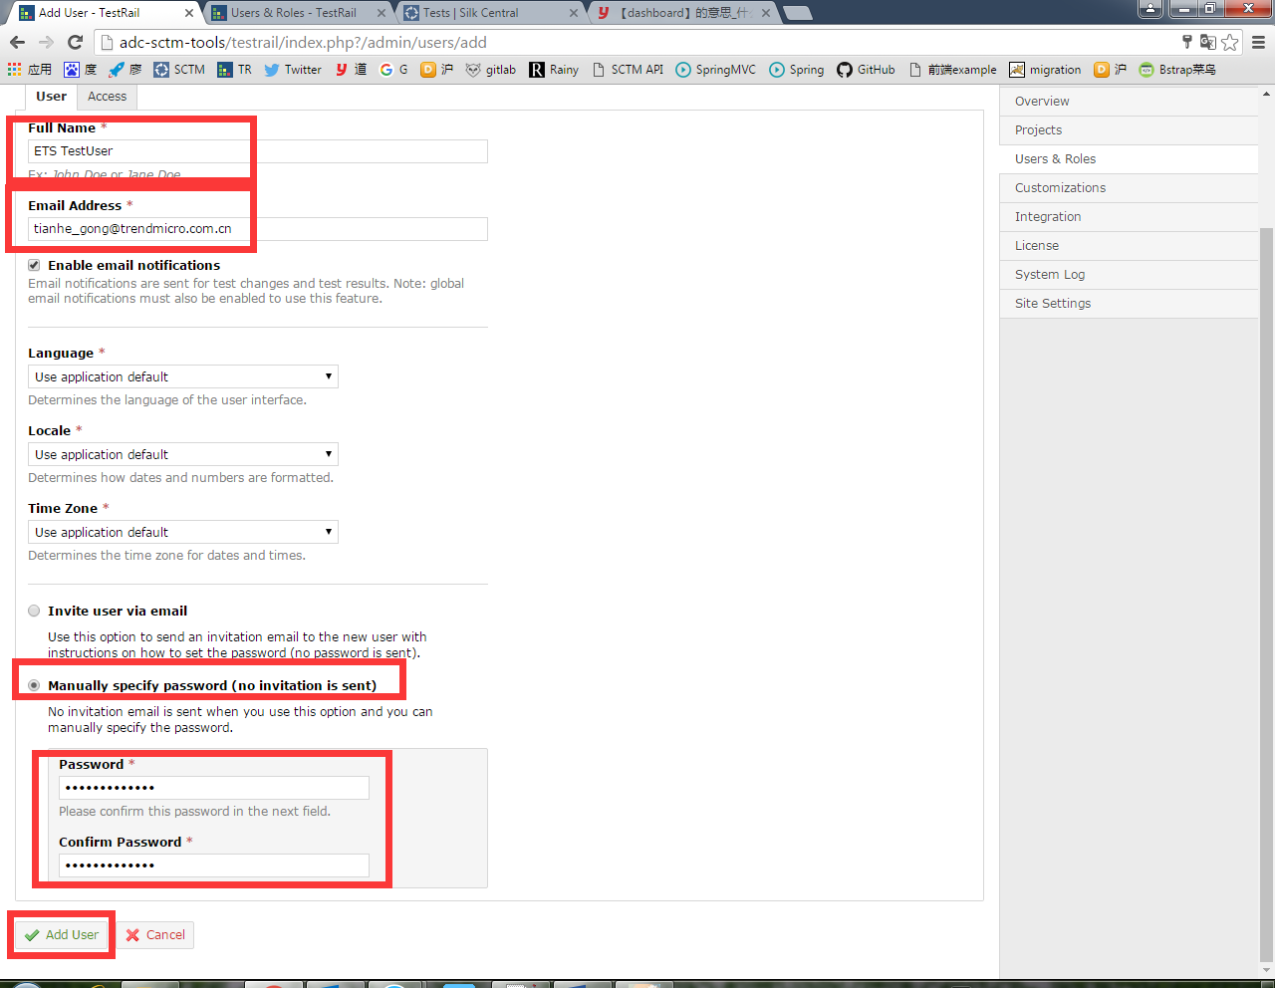
User management
Input full name & email address of new user
TestRail supports LDAP and password authentications.

Slide 13
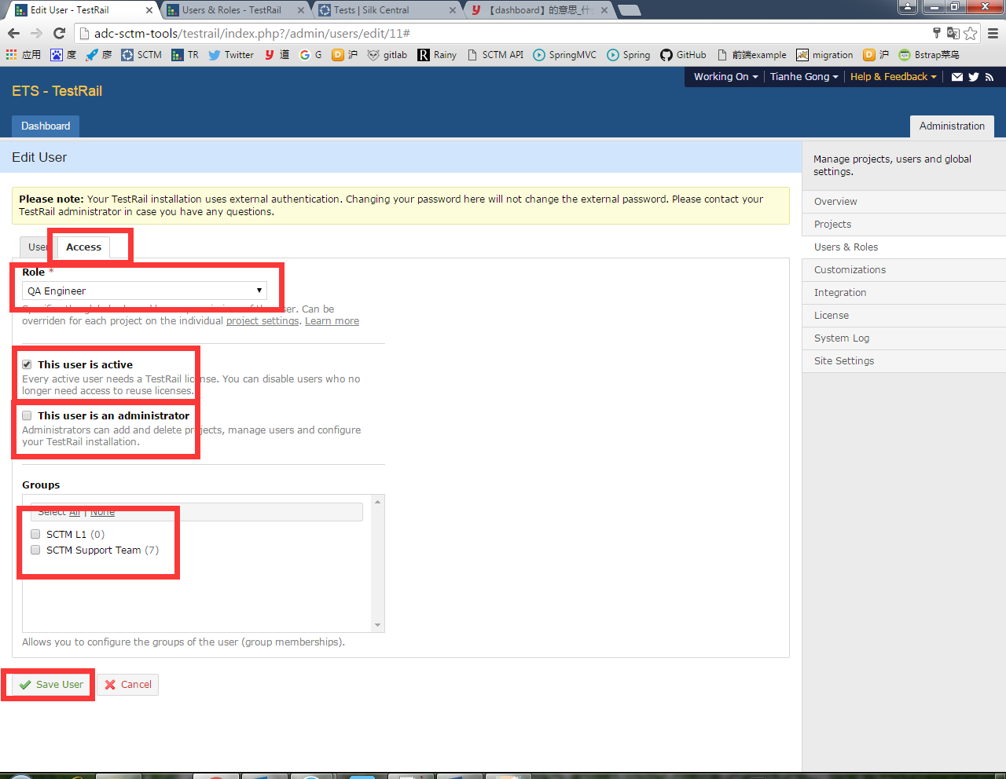
User management
In “Access” tag, we can assign role or groups for this user.
Click to create user

Slide 14
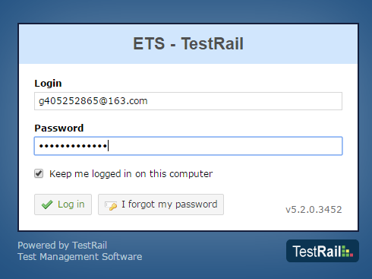
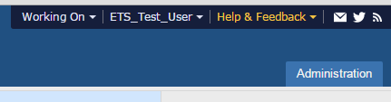
User management
New account can be logged in successfully

Slide 15
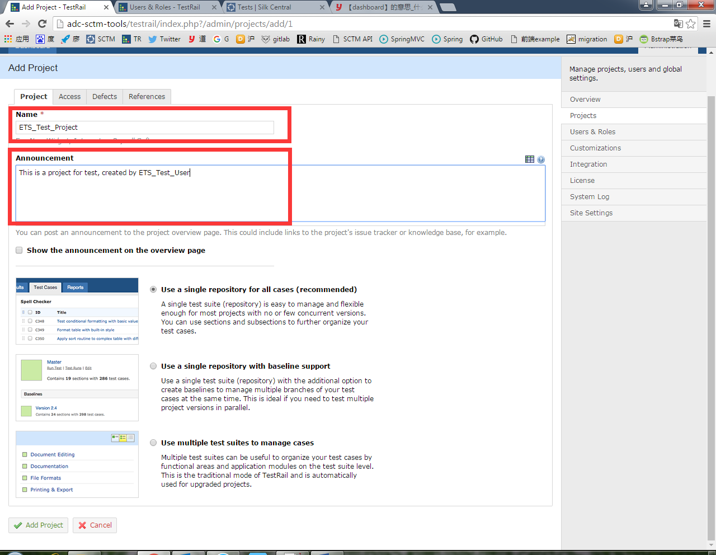
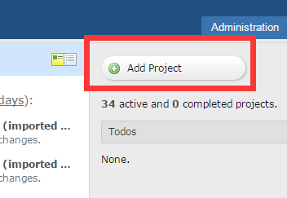
Suite/Section/Case management
Create a new project

Slide 16
Suite/Section/Case management
Three types of projects
1. Single repository for all cases (recommended). A single test suite (repository) is easy to manage and flexible enough for most projects with no or few concurrent versions. You can use sections and subsections to further organize your test cases.
2. Single repository with baseline support. Use a single test suite (repository) with the additional option to create baselines to manage multiple branches of your test cases at the same time. This is ideal if you need to test multiple project versions in parallel.
3. Use multiple test suites to manage cases. Multiple test suites can be useful to organize your test cases by functional areas and application modules on the test suite level. This is the traditional mode of TestRail and is automatically used for upgraded projects.

Slide 17
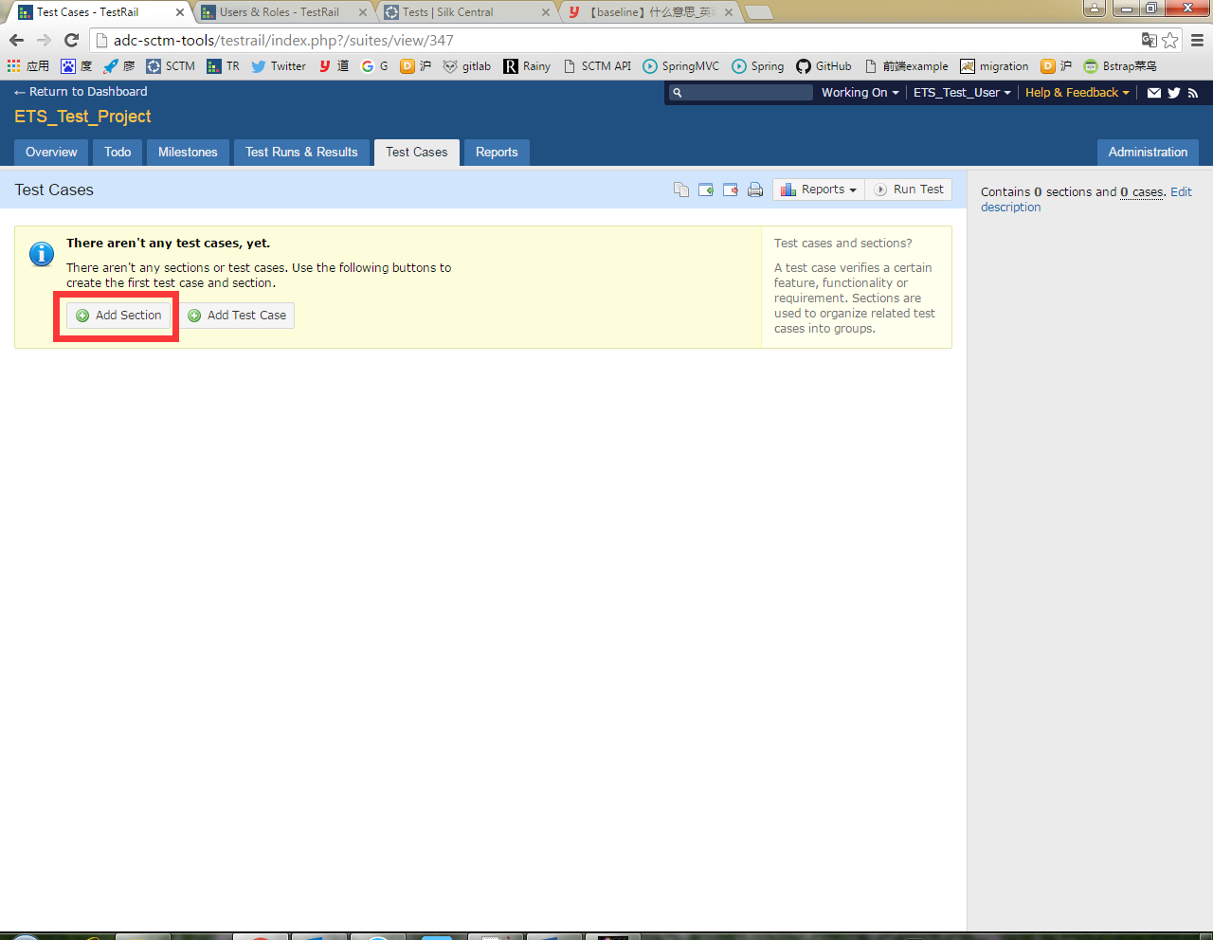
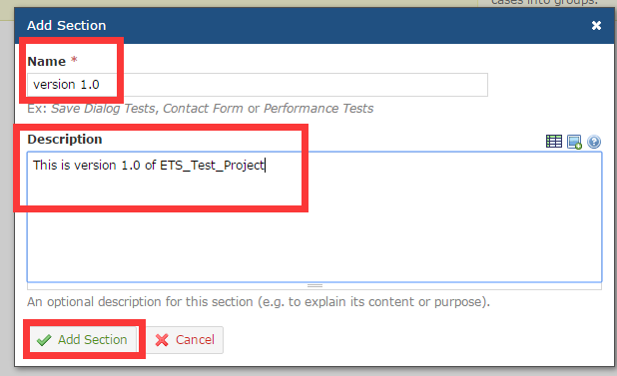
Suite/Section/Case management
In “Test Cases” tag, click “Add Section” to create a new section.

Slide 18
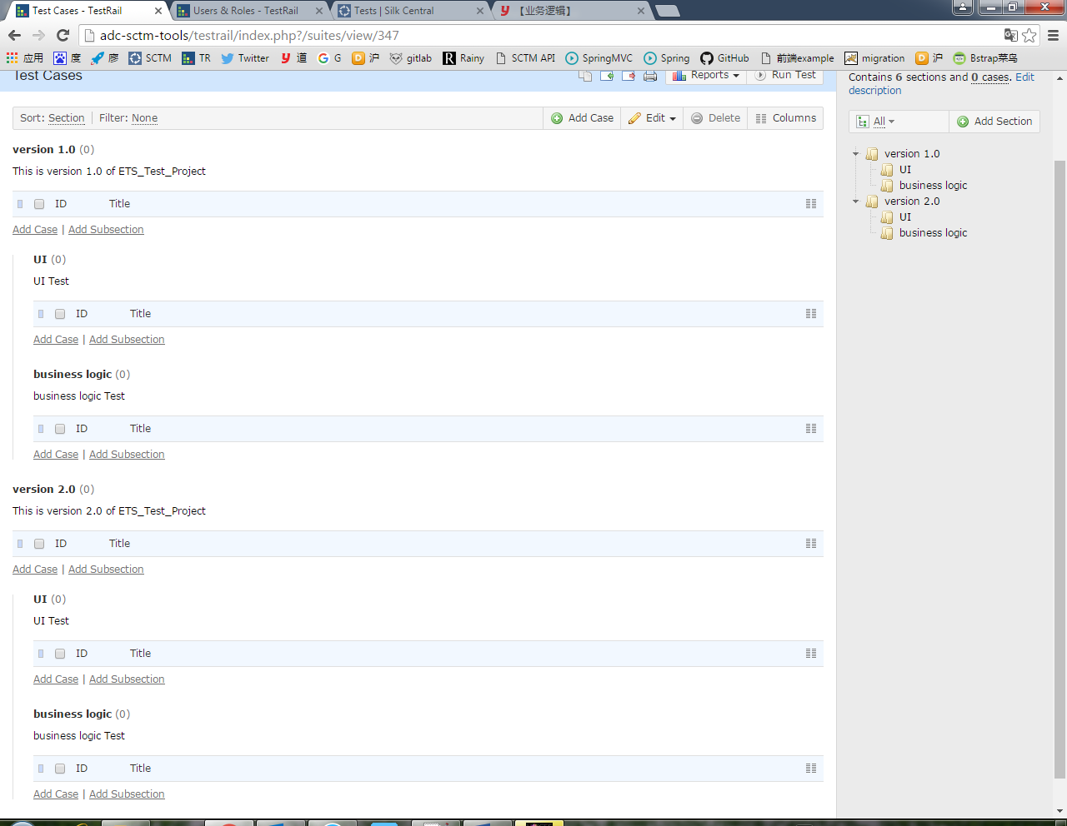
Suite/Section/Case management
Click “Add Section” to create a root section.
Click “Add Subsection” to create a subsection.

Slide 19
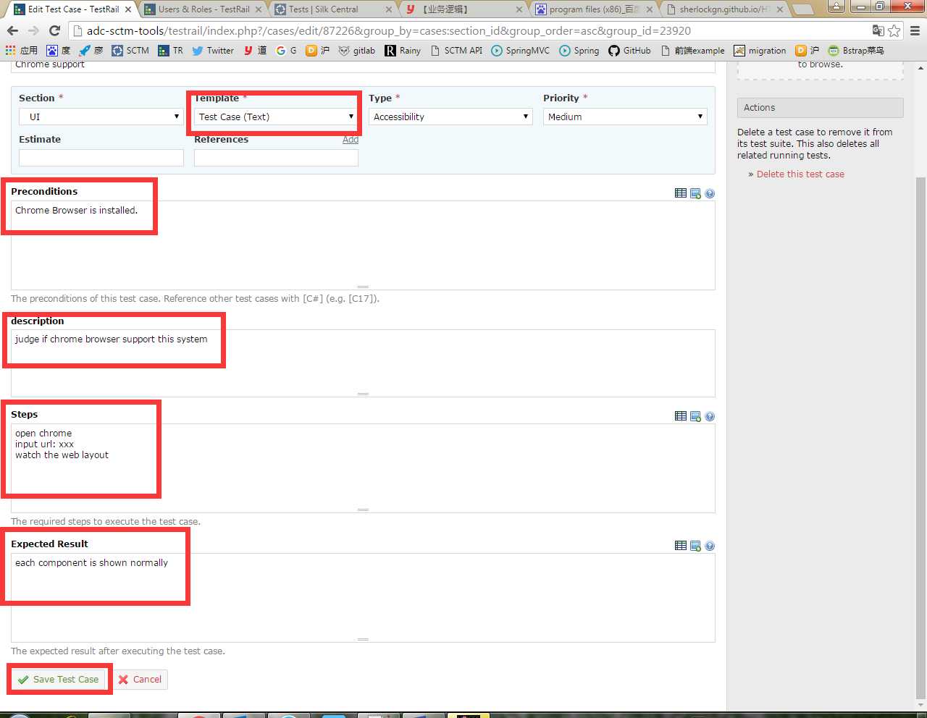
Suite/Section/Case management
In “Text” template, you are required to input preconditions, description, steps and expected result
Create a new test case

Slide 20
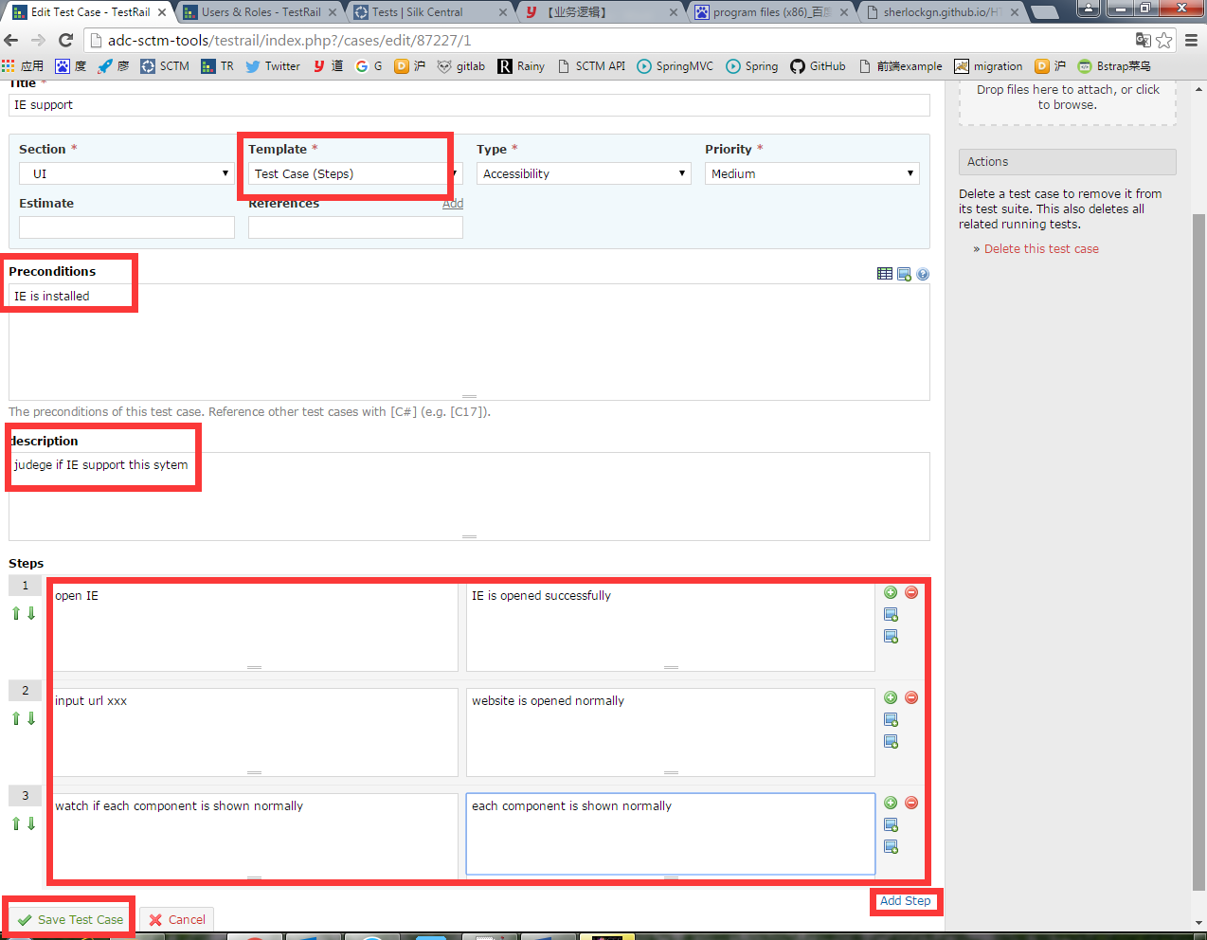
Suite/Section/Case management
In “Step” template, you are required to input preconditions, description and detailed information for each step.

Slide 21
Suite/Section/Case management
TestRail milestone
A milestone can be any project milestone you deem to be important, such as a planned public software release, an internal test version or a new beta release for an important customer. Once you have added your milestones to TestRail, you can assign test runs to specific milestones.
Assigning test runs to milestones has the advantage that you can easily track the milestones' test results and progress separately. Especially if you are working on multiple milestones in parallel or if you have many test runs active at the same time, managing milestones within TestRail is a great help.

Slide 22
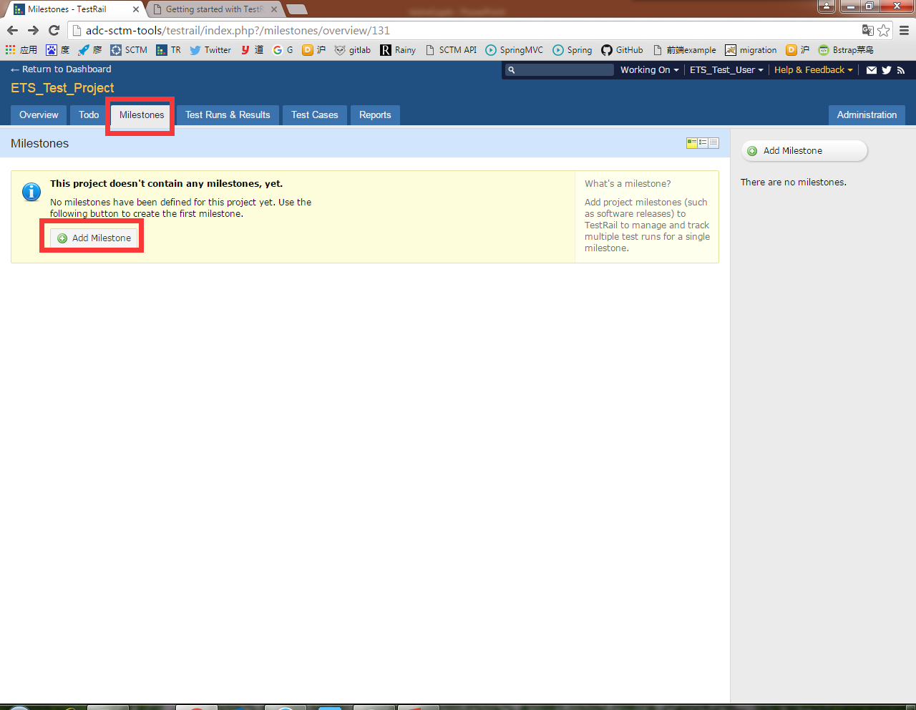
Suite/Section/Case management
In “Milestone” tag, click “Add Milestone” to create a new TestRail milestone

Slide 23
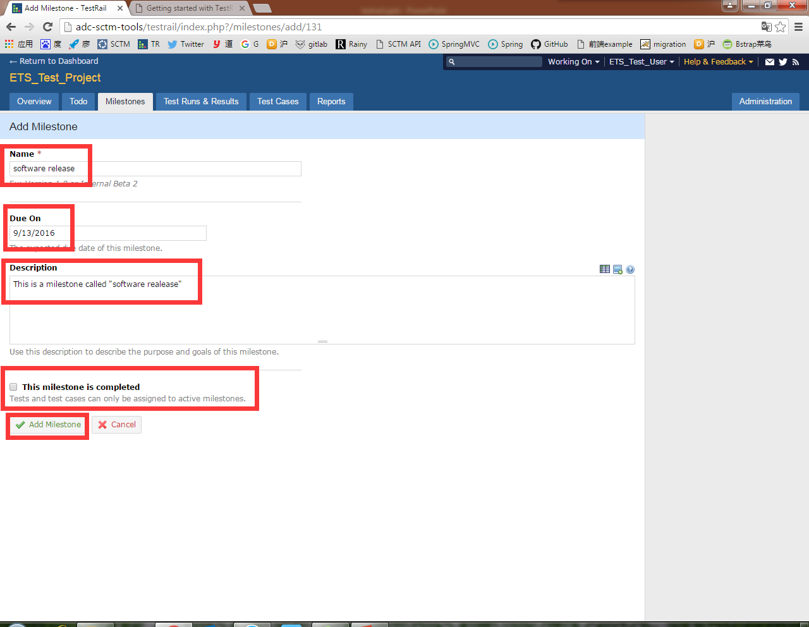
Suite/Section/Case management
Input the name, due on, description and decide if the milestone is completed. Click “Add Milestone” button to create a new milestone.

Slide 24
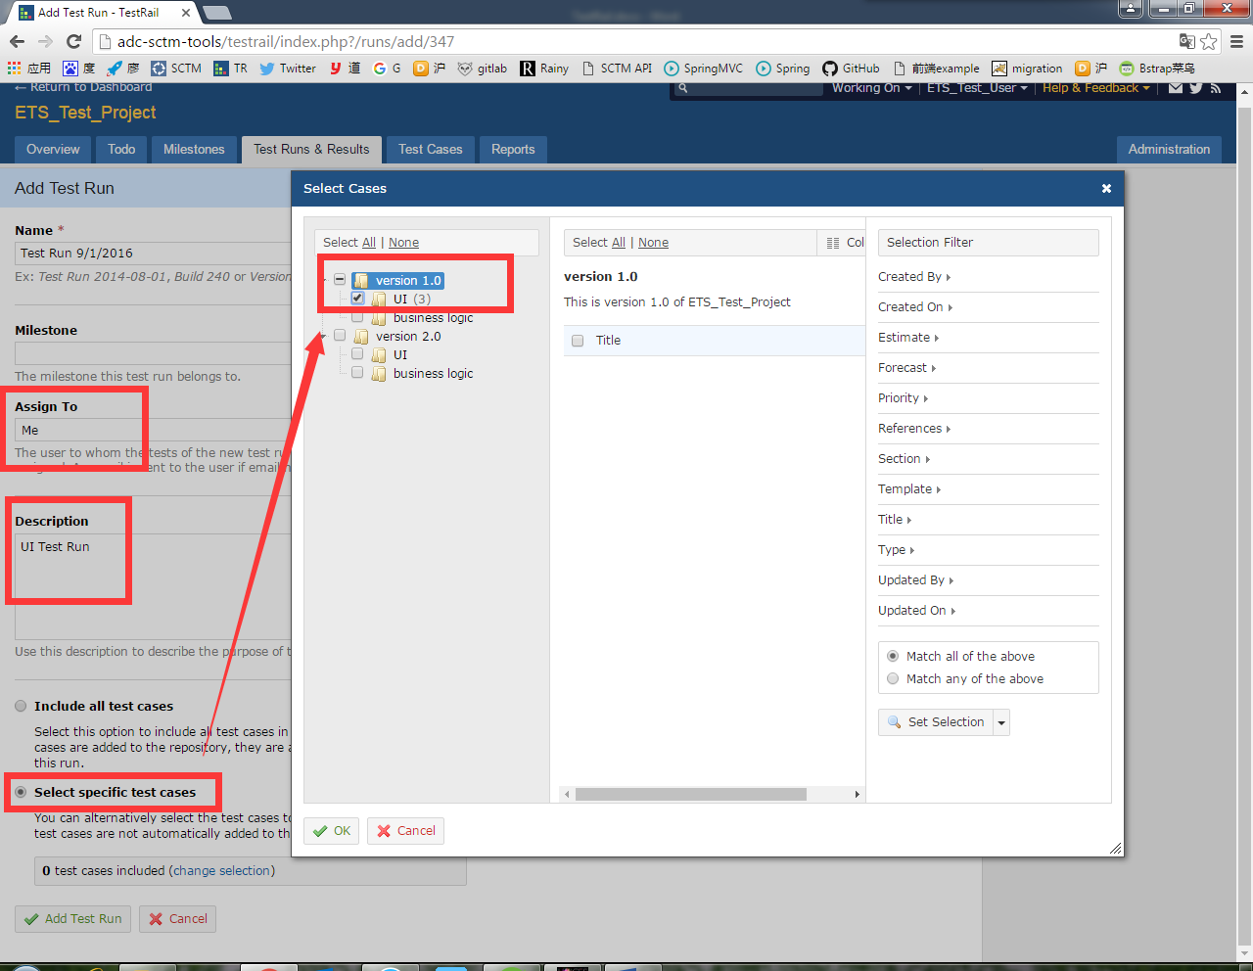
Suite/Section/Case management
Add a test run to execute these cases. Assigned milestone, members, description and cases are required.

Slide 25
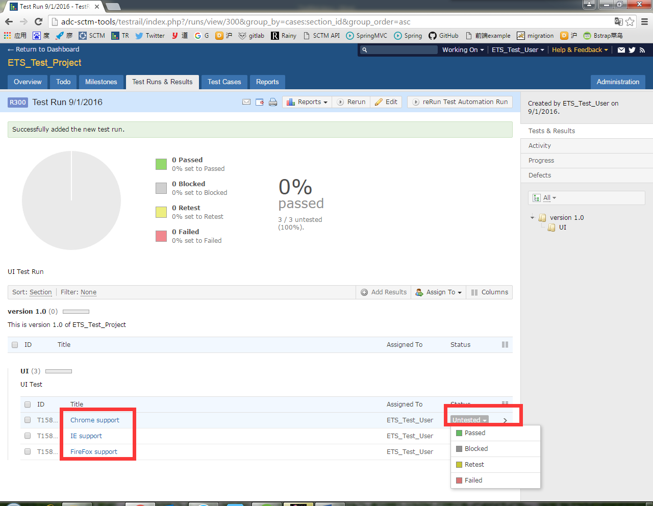
Suite/Section/Case management
Selected test cases are shown here.
You can assign status of this test case.

Slide 26
Suite/Section/Case management
Different statuses of test cases
Untested By default, new tests have the status Untested. Once a test result has been added to a test, it can never receive the Untested status again.
Passed A test is marked as Passed when a tester verified the test steps and the expected results.
Failed A tester marks a test as Failed if one of the specified test steps resulted in an error or if the expected result differs from the actual test result.
Retest If a developer or tester determines that a test should be tested again, she marks the test as Retest. E.g., if a test originally failed and the developer fixed the problem, the developer can mark it to be retested.
Blocked The Blocked status is used to signal that a test cannot be executed currently because of some external dependency (such as a bug that needs to be fixed before being able to complete to test). It is often used in combination with the Retest status.

Slide 27
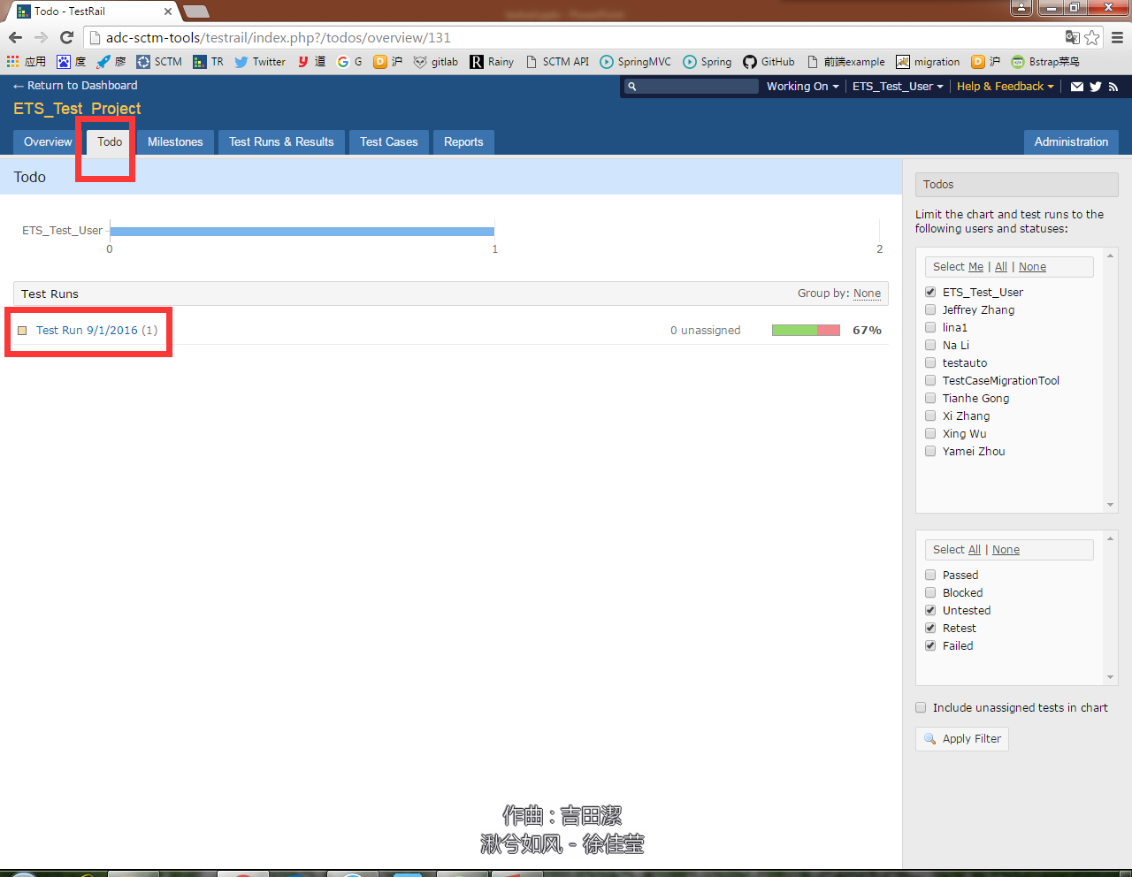
Suite/Section/Case management
In “Todo” tag, the test cases assigned to current user whose statuses are untested, retest or failed are listed here.

Slide 28
Automation Test
TestRail's API can be used to integrate TestRail with various tools, frameworks and third-party applications. For example, many customers use the API to integrate their automated tests and submit test results to TestRail. The API can be used for various other tasks as well and you can find a small list of examples below.
The API is HTTP-based and can thus be used from virtually any framework, programming language and tool. Submitting data to TestRail via the API is done via simple POST requests. Requesting data is done through GET requests. All requests and responses use the JSON format and UTF-8 encoding.

Slide 29
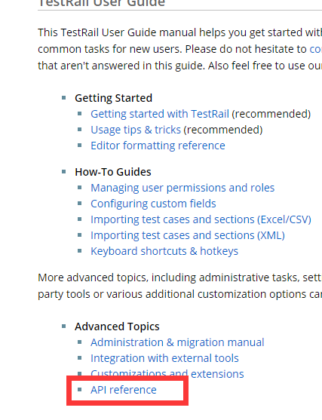
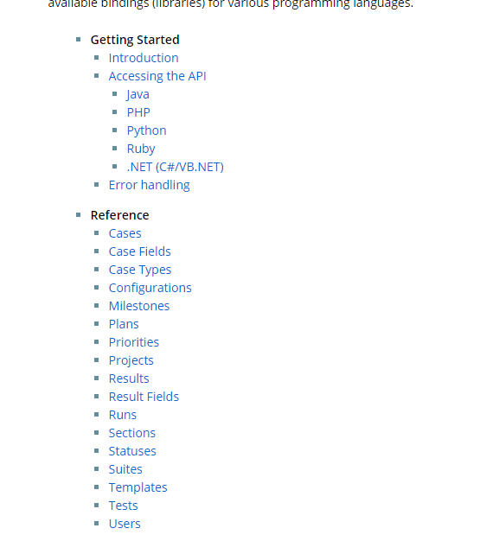
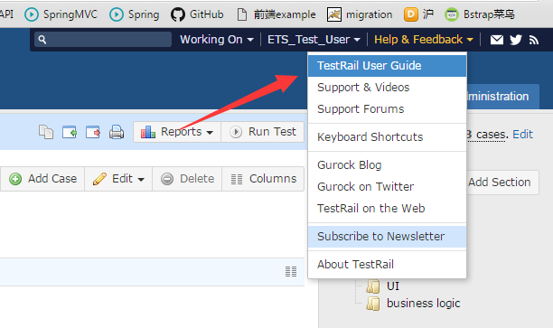
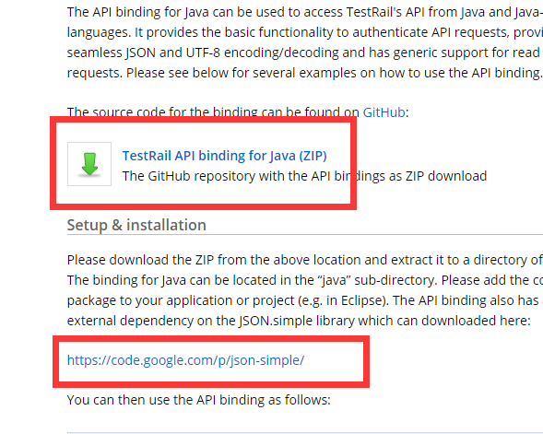
Automation Test
Click here to access the API document.
Take JAVA language as an example, we need to download dependent packages.

Slide 30
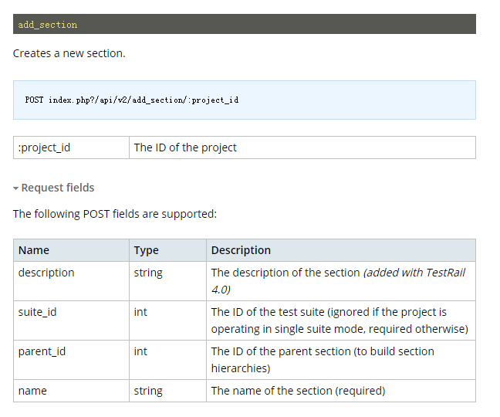
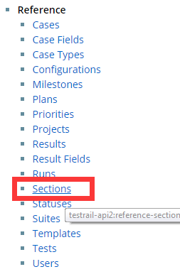
Automation Test
For example, we want to use java to create a new section. Just click “Section” and consult “add_section”. Protocols and JOSN format is introduced clearly in this document.

Slide 31
Automation Test
Different statuses of test cases
Map<String, Object> m = new HashMap<String, Object>();
m.put("name", sectionName);
JSONObject c = (JSONObject)
client.sendPost("add_section/" + projectId, m);
sectionId = (Long) c.get("id");

Slide 32
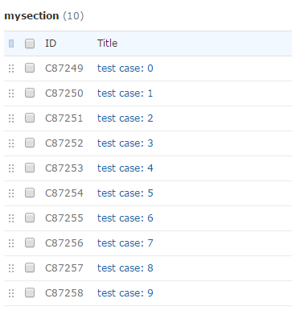
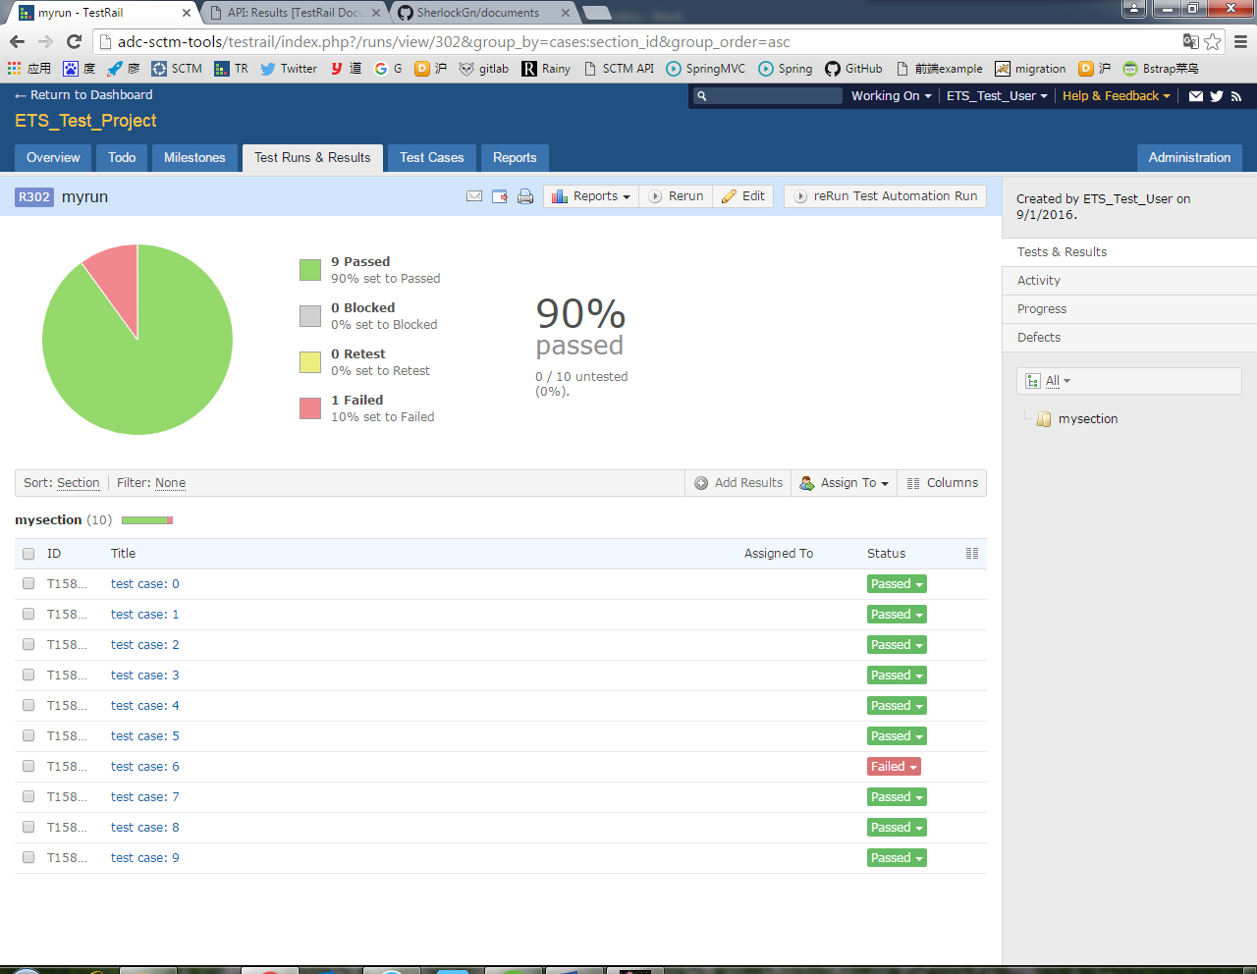
Automation Test
Different statuses of test cases
We can also use API to insert cases (including steps), runs and results.

Slide 33
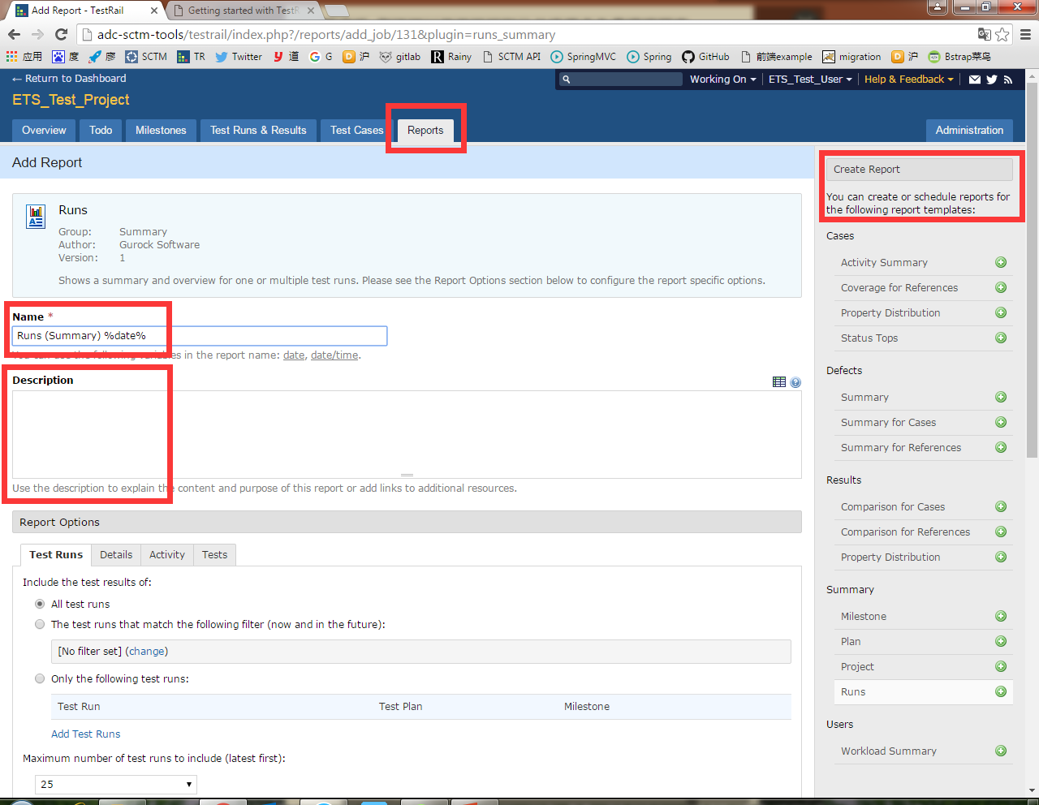
Report generation
The following templates are supported
Click “Report” tag to create a new report
Input name and description

Slide 34
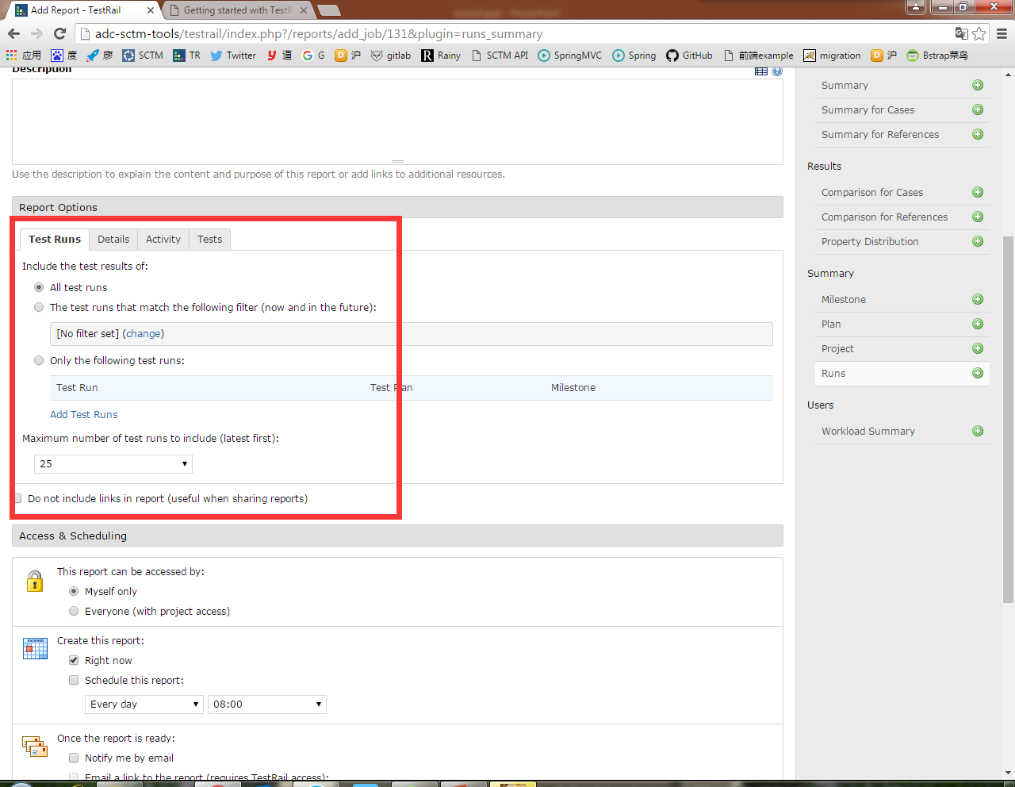
Report generation
You can configure the report detailedly in “Report Options”

Slide 35
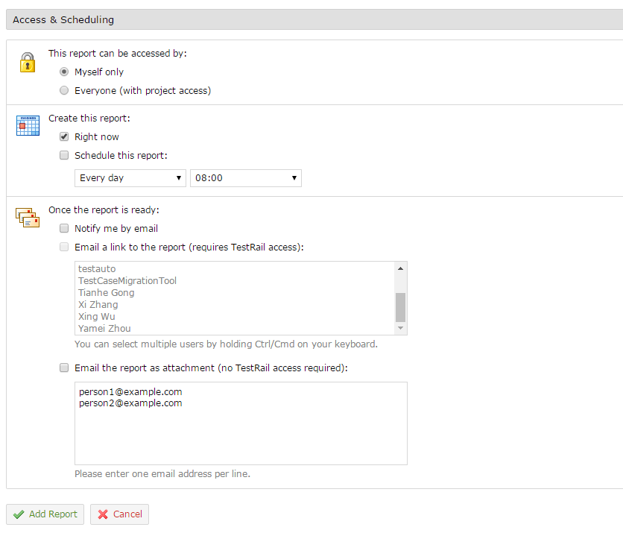
Report generation
You can decide who & when the notification will inform.
Click “Add Report” to generate a report.

Slide 36
Thank you!
Reference Links:
TestRail System: http://adc-sctm-tools/testrail/index.php
TestRail User Guide: http://docs.gurock.com/testrail-userguide/start
TestRail API: http://docs.gurock.com/testrail-api2/start

